Slide 1
Chapter 21
Electric Charge and Electric Field

Slide 2
Learning Goals for Lecture 1
Looking forward at …
how objects become electrically charged, and how we know that electric charge is conserved.
how to use Coulomb’s law to calculate the electric force between charges.

Slide 3

Introduction
Water makes life possible: The cells of your body could not function without water in which to dissolve essential biological molecules.
What electrical properties of the water molecule allow it to be such a good solvent?
We now begin our study of electromagnetism, one of the four fundamental forces.
We start with electric charge and look at electric fields.

Slide 4
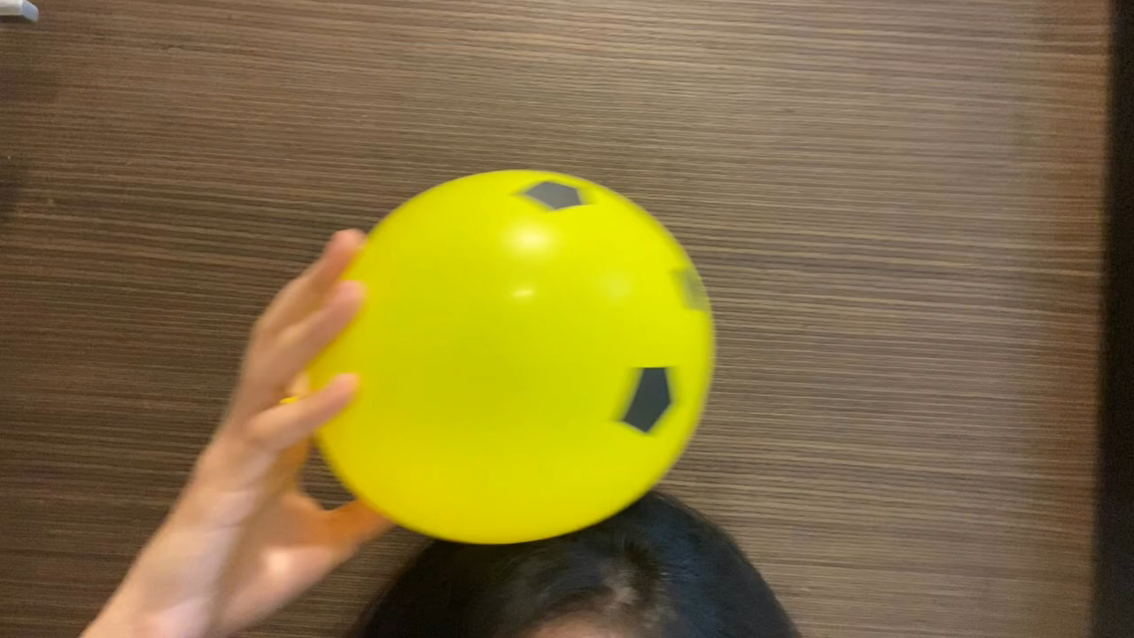

Slide 5
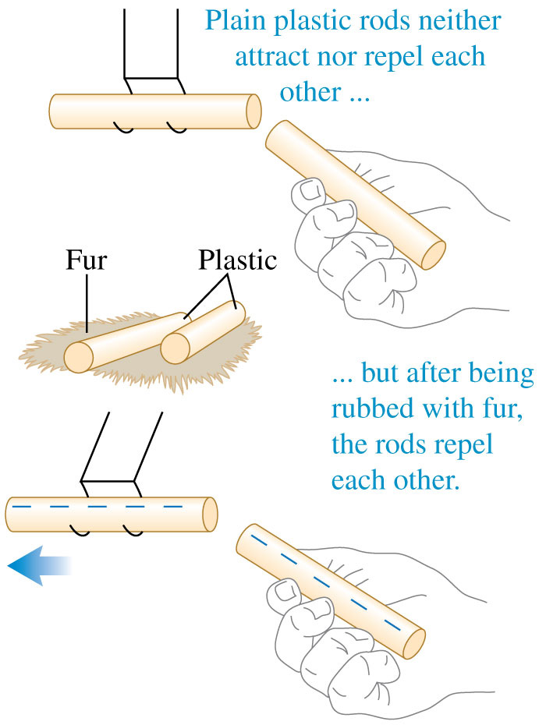
Electric charge
Plastic rods and fur (real or fake) are particularly good for demonstrating electrostatics, the interactions between electric charges that are at rest (or nearly so).
After we charge both plastic rods by rubbing them with the piece of fur, we find that the rods repel each other.

Slide 6
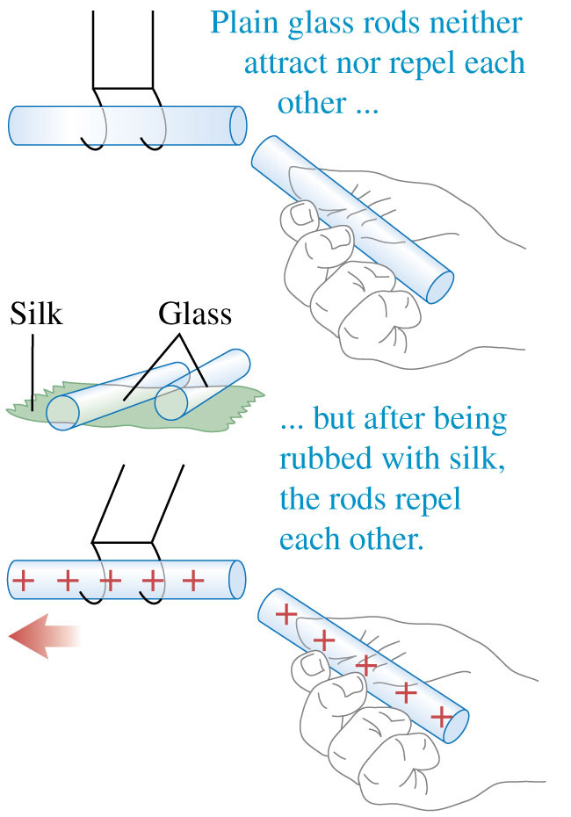
Electric charge
When we rub glass rods with silk, the glass rods also become charged and repel each other.

Slide 7
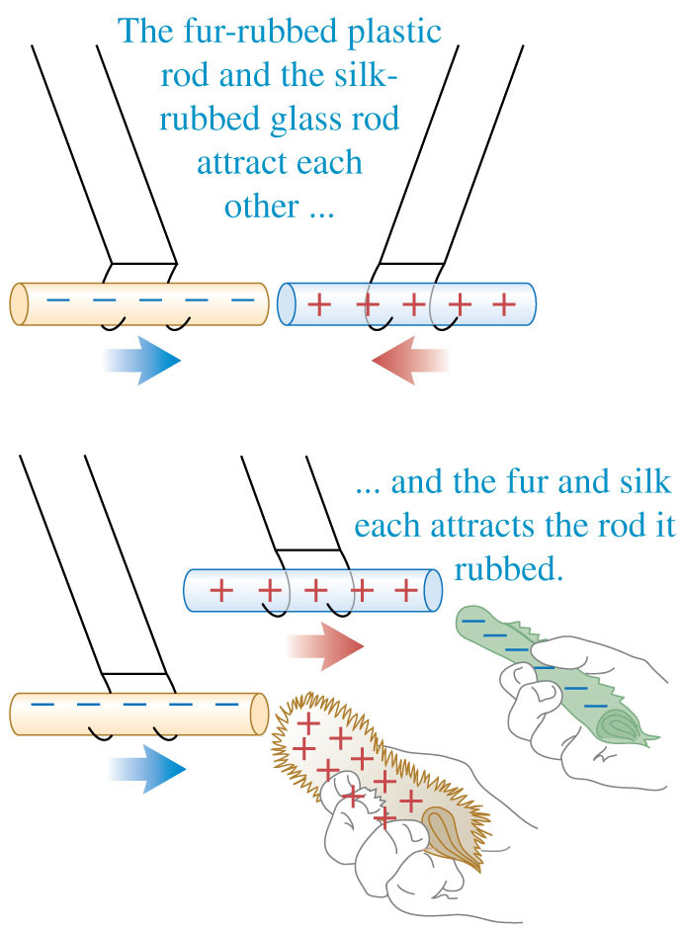
Electric charge
A charged plastic rod attracts a charged glass rod; furthermore, the plastic rod and the fur attract each other, and the glass rod and the silk attract each other.
These experiments and many others like them have shown that there are exactly two kinds of electric charge: The kind on the plastic rod rubbed with fur (negative) and the kind on the glass rod rubbed with silk (positive).

Slide 8
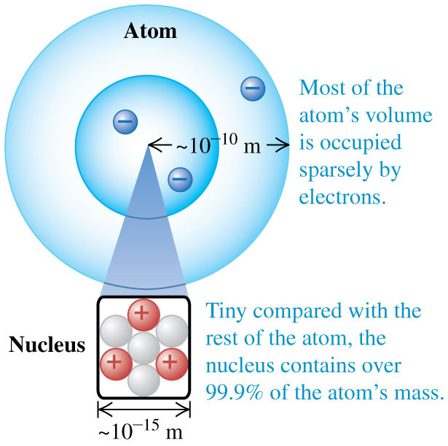
Electric charge and the structure of matter
The particles of the atom are the negative electrons (dark blue spheres in this figure), the positive protons (red spheres), and the uncharged neutrons (gray spheres).
Protons and neutrons make up the tiny dense nucleus, which is surrounded by electrons.

Slide 9
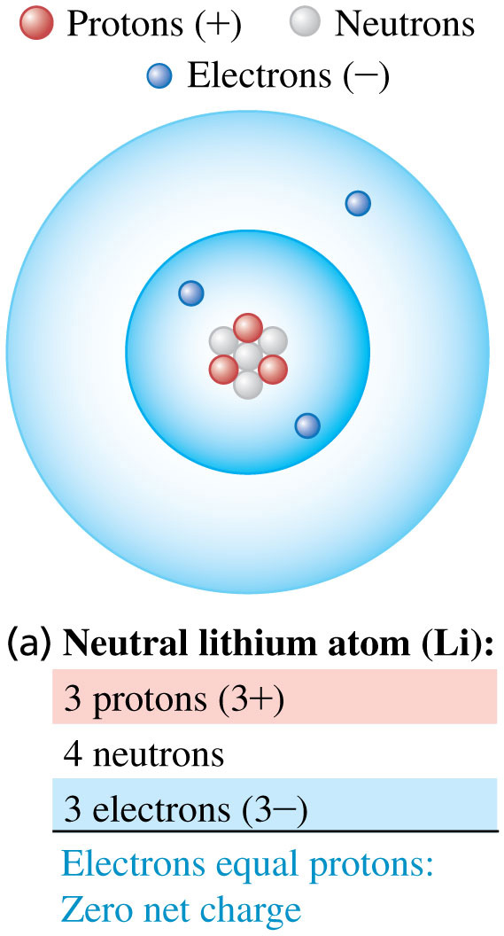
Atoms and ions
A neutral atom has the same number of protons as electrons.
The electron “shells” are a schematic representation of the actual electron distribution, a diffuse cloud many times larger than the nucleus.

Slide 10
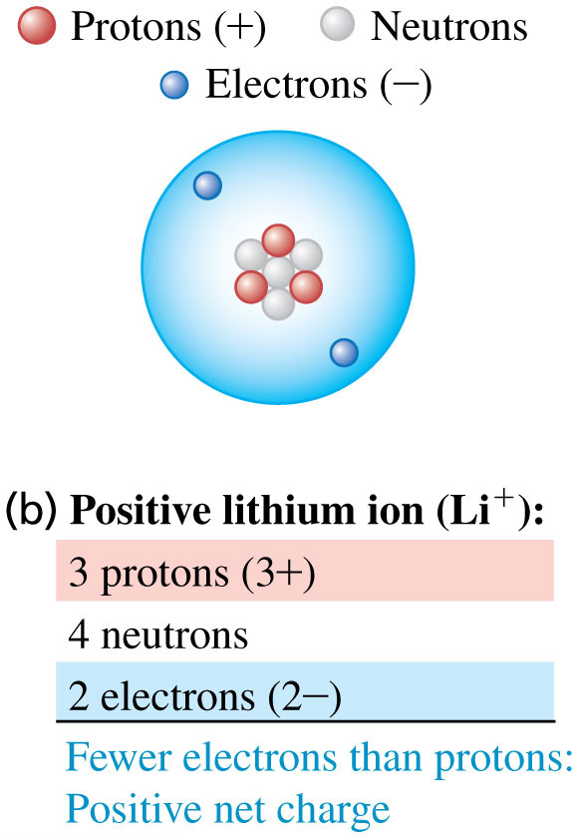
Atoms and ions
A positive ion is an atom with one or more electrons removed.

Slide 11
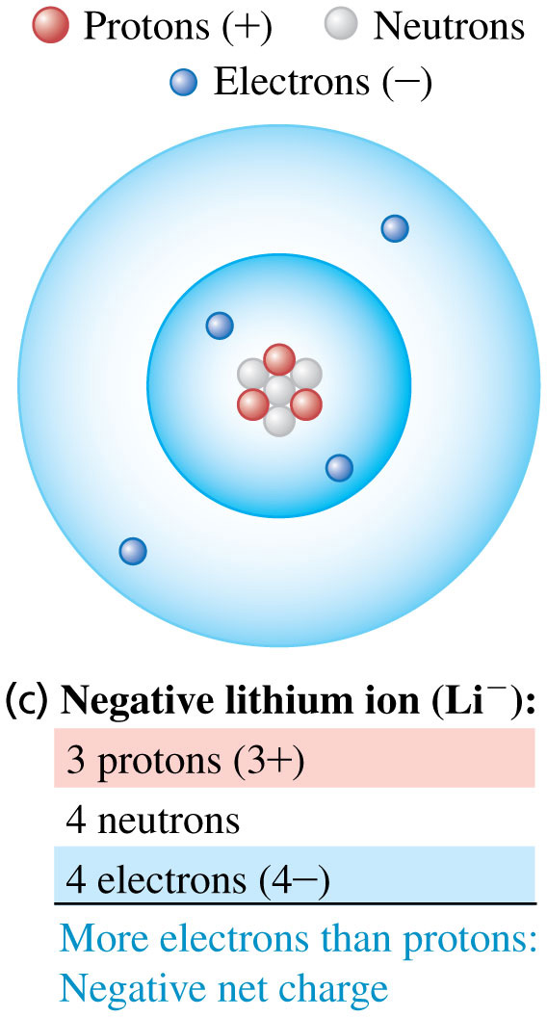
Atoms and ions
A negative ion is an atom with an excess of electrons.

Slide 12
Conservation of charge
The proton and electron have the same magnitude charge.
The magnitude of charge of the electron or proton is a natural unit of charge. All observable charge is quantized in this unit.
The universal principle of charge conservation states that the algebraic sum of all the electric charges in any closed system is constant.

Slide 13
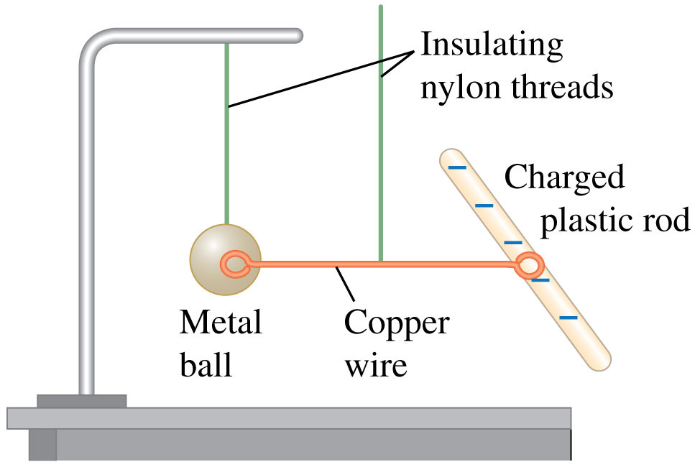
Conductors and insulators
Copper is a good conductor of electricity; nylon is a good insulator. The copper wire shown conducts charge between the metal ball and the charged plastic rod to charge the ball negatively.

Slide 14
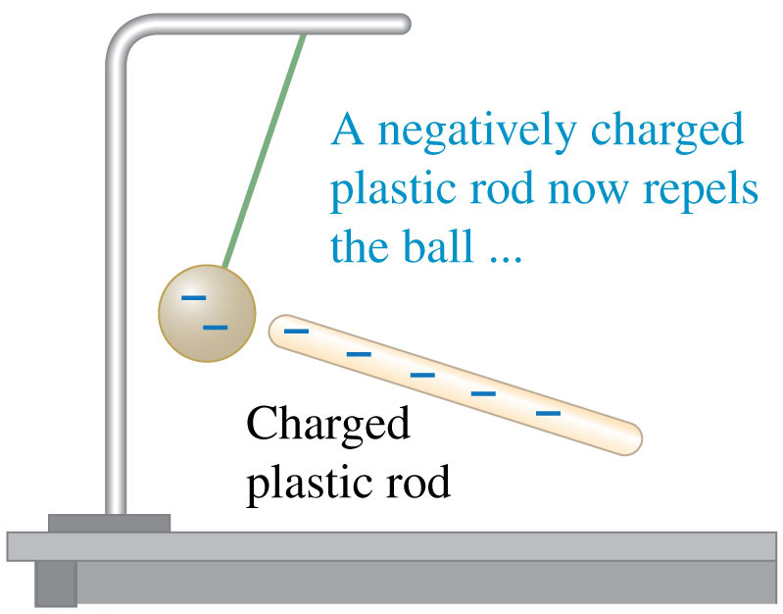
Conductors and insulators
After it is negatively charged, the metal ball is repelled by a negatively charged plastic rod.

Slide 15
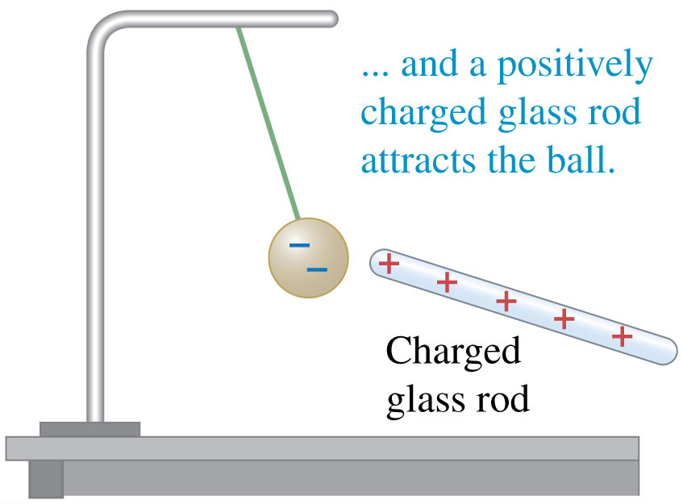
Conductors and insulators
After it is negatively charged, the metal ball is attracted by a positively charged glass rod.

Slide 16
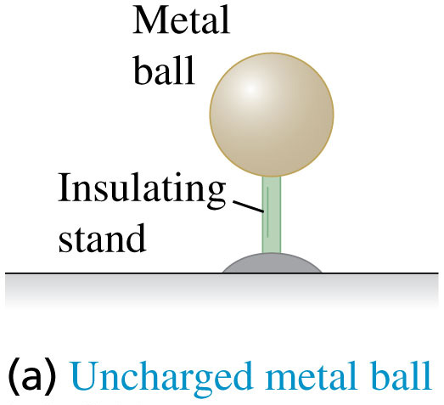
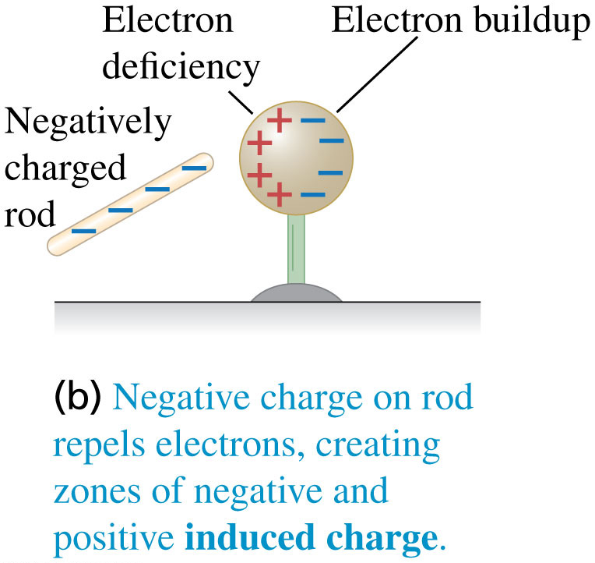
Charging by induction in 4 steps: Steps 1 and 2
Start with an uncharged metal ball supported by an insulating stand.
When you bring a negatively charged rod near it, without actually touching it, the free electrons in the metal ball are repelled by the excess electrons on the rod, and they shift toward the right, away from the rod.

Slide 17
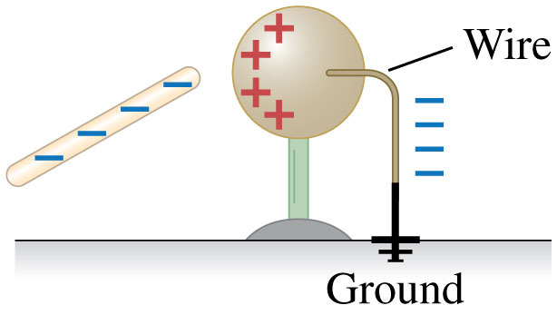
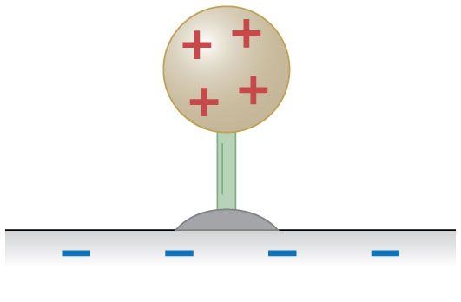
Charging by induction in 4 steps: Steps 3 and 4
While the plastic rod is nearby, you touch one end of a conducting wire to the right surface of the ball and the other end to the ground.
Now disconnect the wire, and then remove the rod. A net positive charge is left on the ball. The earth acquires a negative charge that is equal in magnitude to the induced positive charge remaining on the ball.

Slide 18
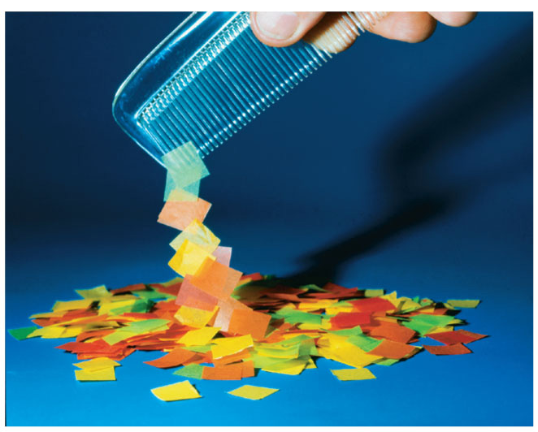
Electric forces on uncharged objects
A charged body can exert forces even on objects that are not charged themselves.
If you rub a balloon on the rug and then hold the balloon against the ceiling, it sticks, even though the ceiling has no net electric charge.
After you electrify a comb by running it through your hair, you can pick up uncharged bits of paper or plastic with it.
How is this possible?

Slide 19
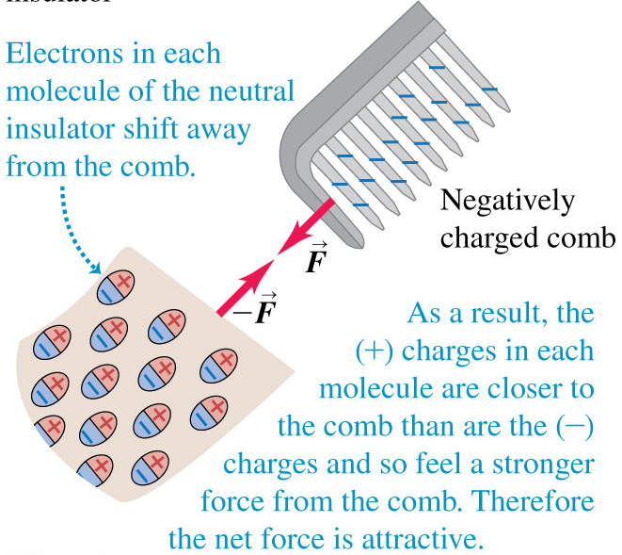
Electric forces on uncharged objects
The negatively charged plastic comb causes a slight shifting of charge within the molecules of the neutral insulator, an effect called polarization.

Slide 20
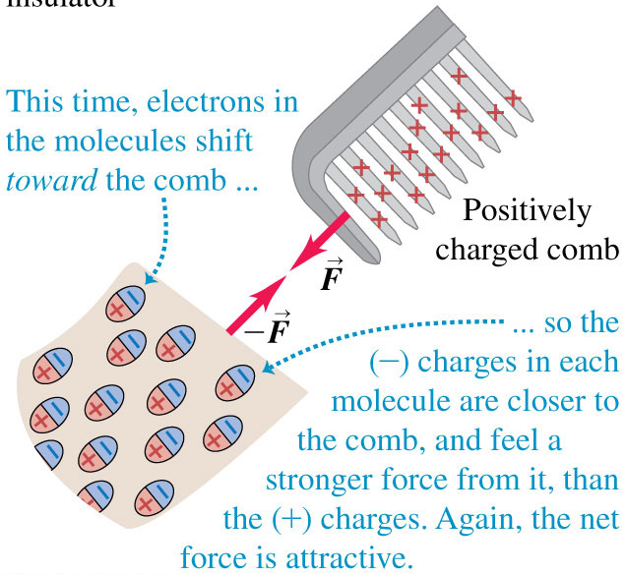
Electric forces on uncharged objects
Note that a neutral insulator is also attracted to a positively charged comb.
A charged object of either sign exerts an attractive force on an uncharged insulator.

Slide 21
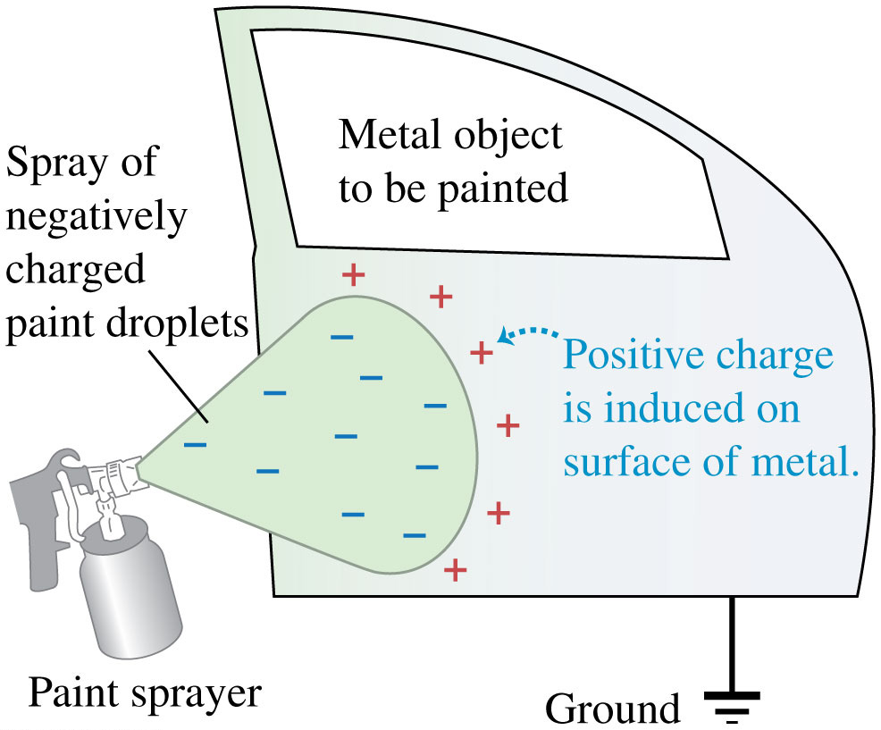
Electrostatic painting
Induced positive charge on the metal object attracts the negatively charged paint droplets.

Slide 22
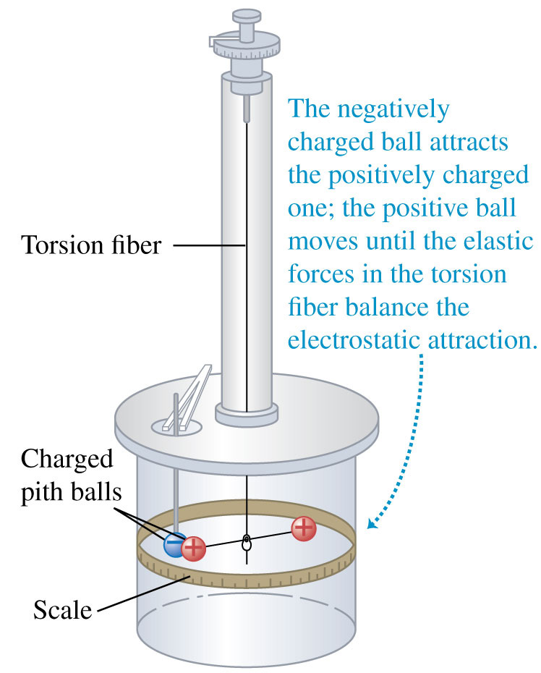
Measuring the electric force between point charges
Coulomb studied the interaction forces of charged particles in detail in 1784.
He used a torsion balance similar to the one used 13 years later by Cavendish to study the much weaker gravitational interaction.
For point charges, Coulomb found that the magnitude of the electric force is inversely proportional to the square of the distance between the charges.

Slide 23
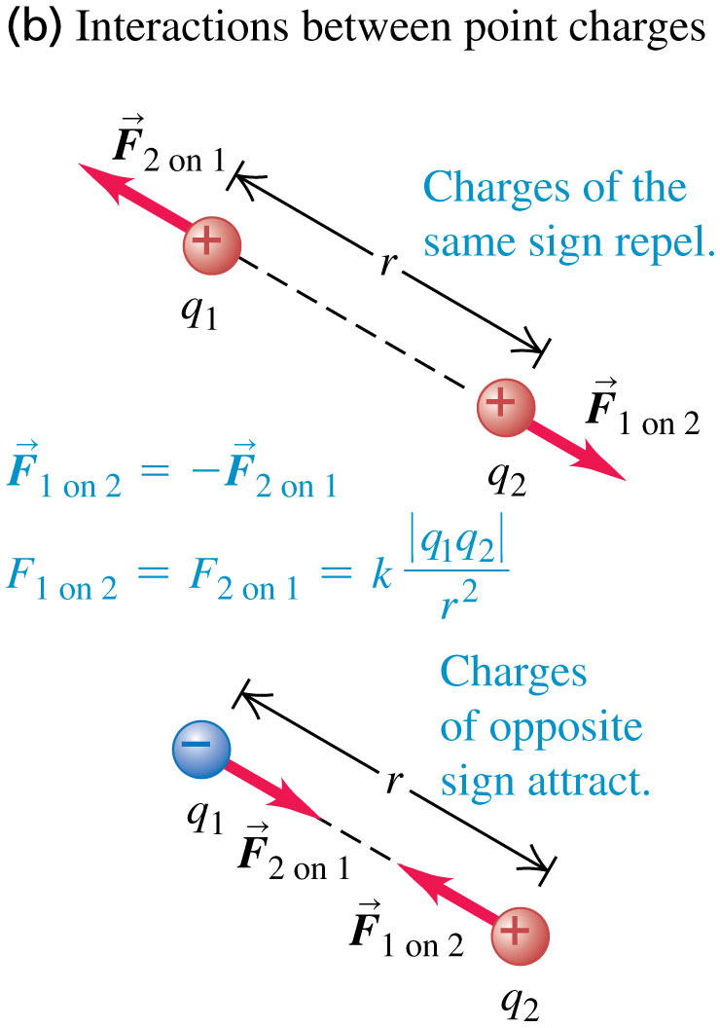
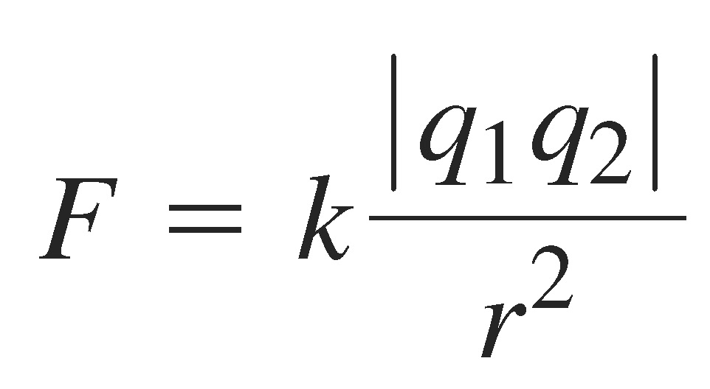
Coulomb’s Law
Coulomb’s Law: The magnitude of the electric force between two point charges is directly proportional to the product of their charges and inversely proportional to the square of the distance between them.

Slide 28
The total force on Q is in the +x-direction, with magnitude 0.46 N.

Slide 29
Summary
The directions of the forces the two charges exert on each other are always along the line joining them.

